Slide 1




Presenters:
Fyodor Morozko
Roza Navitskaya

Slide 2
Outline
Design of nanophotonic structures
Inverse design problem
Tandem neural network
Design of multilayer structures
Our simulation results
Conclusion

Slide 3
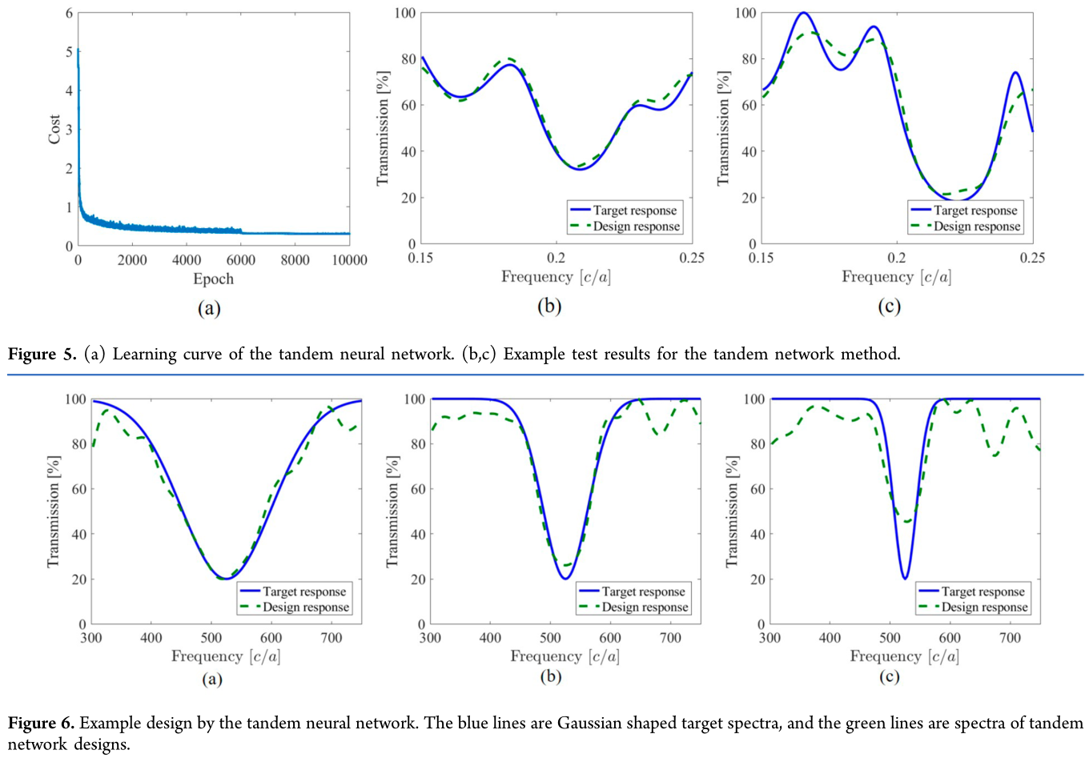
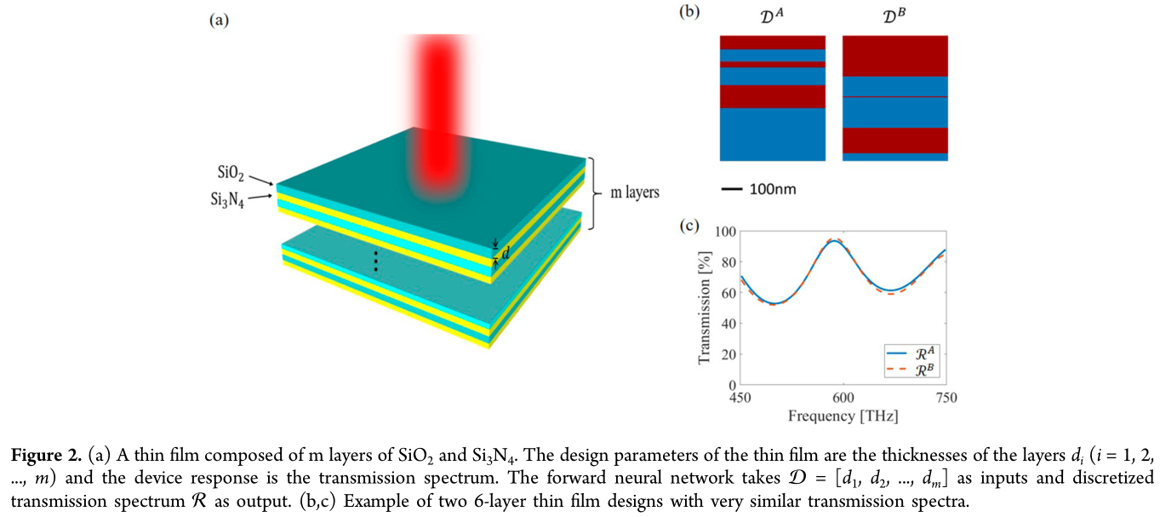
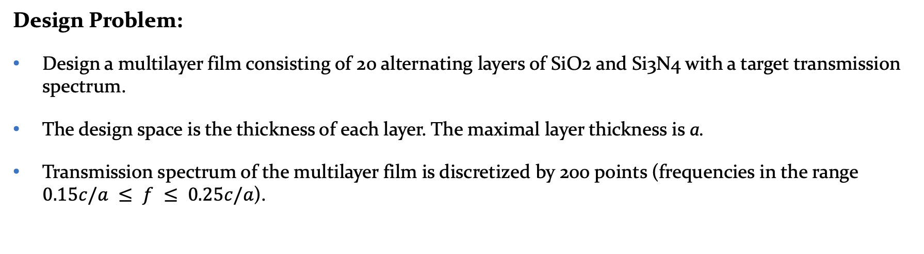
Design of Nanophotonic Structures
Design Problem:
Design a multilayer film consisting of 20 alternating layers of SiO2 and Si3N4 with a target transmission spectrum.
The design space is the thickness of each layer. The maximal layer thickness is a.
Transmission spectrum of the multilayer film is discretized by 200 points (frequencies in the range $0.15c/a ≤ f ≤ 0.25c/a$).
Notes:
Roza

Slide 4


Design of Nanophotonic Structures
Approaches in nanophotonic structures design:
Conventional: iteratively performed optimization (evolutionary algorithms, adjoint methods, optimization of specific geometric parameters)
straightforward methods based on electromagnetic simulations
can be computationally expensive and slow, as each design requires a large amount of simulations
Data-driven: based on machine learning techniques (NNs are trained to assist in the design process)
greatly reduced design time, as simulations are performed only once before training the NN
inverse design problem can lead to bad convergence of the NN
Notes:
Fyodor

Slide 5
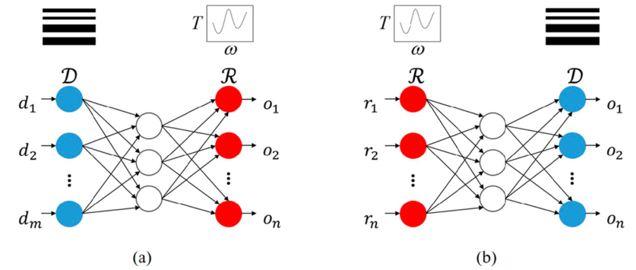
Design of Nanophotonic Structures
NNs can be used in two different ways:
(a) Forward-modeling networks: take the input of the structural parameter D (such as the geometrical shape of a nanostructure) and predict the electromagnetic response R of the device.
(b) Inverse-design networks: take the EM response R as the input and directly output the structure D.
Notes:
Roza

Slide 6
Inverse Design Problem
Inverse Design Problem is Ill Posed:
The same EM response R can be created by many different designs D. This nonunique response-to-design mapping creates conflicting training instances, such as (R, D^{A}) and (R, D^{B}).
When such conflicting instances with the same input but different output labels exist in the training data set, the neural network would be hard to converge.
Notes:
Roza

Slide 7
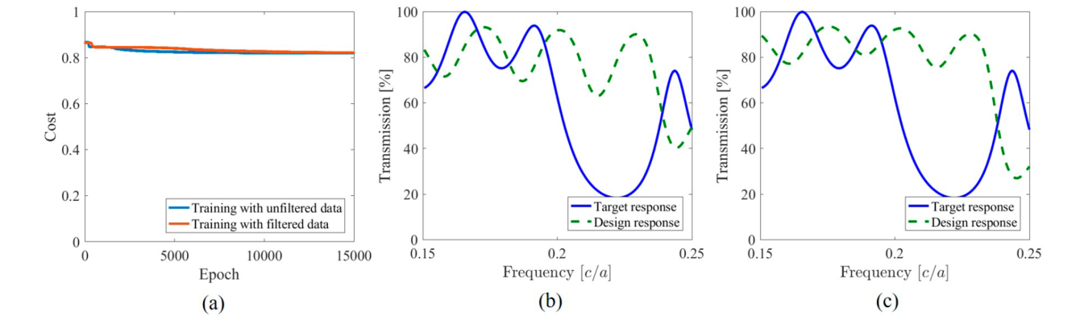
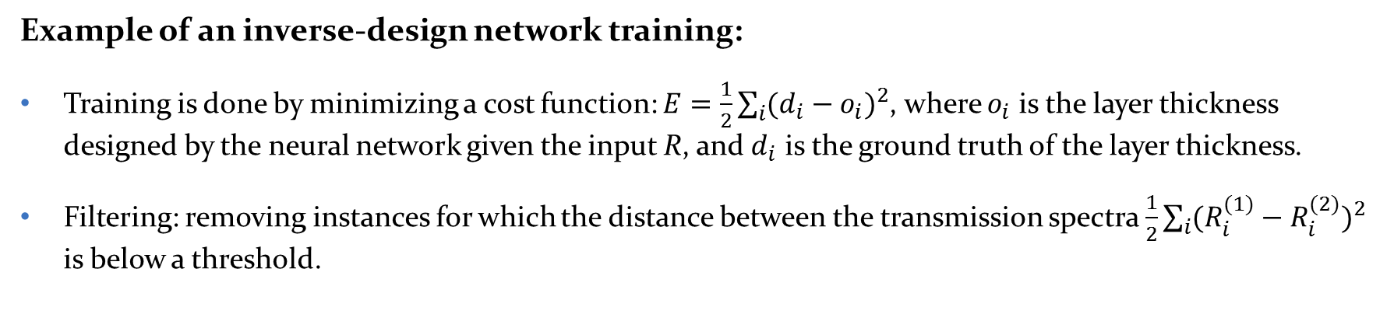
Inverse Design Problem
Example of an inverse-design network training:
Training is done by minimizing a cost function: $E=\frac{1}{2}\sum_{i}{{(d_{i}−o_{i})}^{2}}$, where $o_{i}$ is the layer thickness designed by the neural network given the input R, and $d_{i}$ is the ground truth of the layer thickness.
Filtering: removing instances for which the distance between the transmission spectra $\frac{1}{2}\sum_{i}{{(R_{i}^{(1)}−R_{i}^{(2)})}^{2}}$ is below a threshold.
Nonunique instances are present (unfiltered data)
Nonunique instances are eliminated (filtered data)
Notes:
Roza

Slide 8
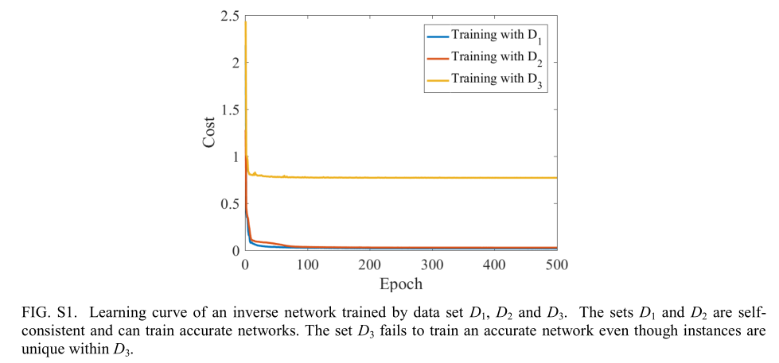
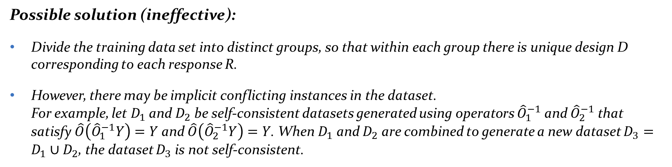
Inverse Design Problem
Possible solution (ineffective):
Divide the training data set into distinct groups, so that within each group there is unique design D corresponding to each response R.
However, there may be implicit conflicting instances in the dataset. For example, let $D_{1}$ and $D_{2}$ be self-consistent datasets generated using operators ${\hat{O}}_{1}^{−1}$ and ${\hat{O}}_{2}^{−1}$ that satisfy $\hat{O}\left({\hat{O}}_{1}^{−1}Y\right)=Y$ and $\hat{O}\left({\hat{O}}_{2}^{−1}Y\right)=Y$. When $D_{1}$ and $D_{2}$ are combined to generate a new dataset $D_{3}=D_{1}∪D_{2}$, the dataset $D_{3}$ is not self-consistent.

Slide 9
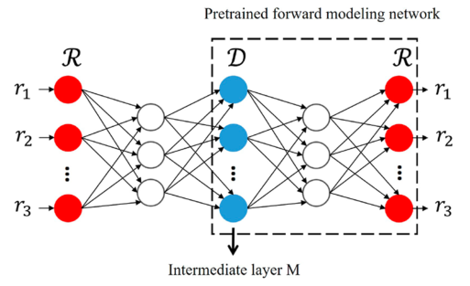
Inverse Design Problem
Proposed solution:
Use a tandem network. By cascading an inverse-design network with a forward-modeling network, the tandem network can be trained effectively.
A desired response R is taken as the input. The output by the intermediate layer M is the designed structure D. The output of the tandem network is the response calculated from the designed structure.
The forward modeling network is trained in advance. Then, the weights in the pretrained forward modeling network are fixed and the weights in the inverse network are adjusted to reduce the cost.
Notes:
Proposed solution:
This network structure overcomes the issue of nonuniqueness in the inverse scattering of electromagnetic waves because the design by the neural network is not required to be the same as the real design in training samples.
Instead, the cost function would be low as long as the generated design and the real design have similar response.

Slide 10
Tandem Neural Network
Proposed solution:
This network structure overcomes the issue of nonuniqueness in the inverse scattering of electromagnetic waves because the design by the neural network is not required to be the same as the real design in training samples.
Instead, the cost function would be low as long as the generated design and the real design have similar response.

Slide 11
Tandem Neural Network
Training a tandem network:
The inverse network architecture is set to have four layers with each layer having 200−500−200−20 units.
Training set: 500 000 instances, test set: 50000 instances.

Slide 12
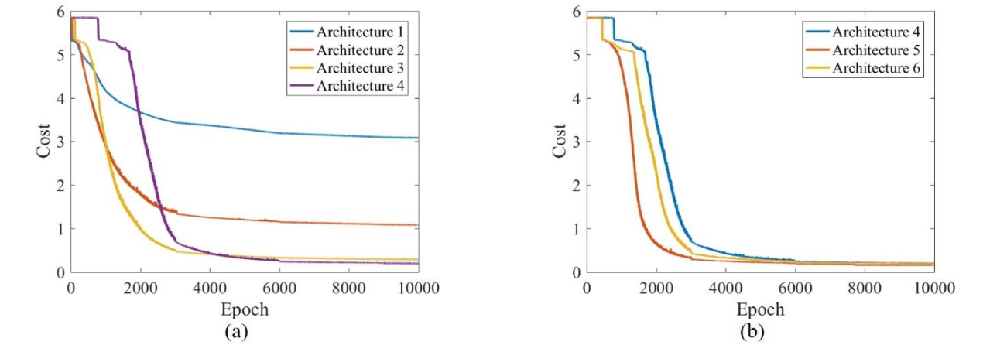
Tandem Neural Network
Training a forward-modeling network:
The number of hidden layers and weights in them can be varied.
Architecture 1: 20 − 500 − 200
Architecture 2: 20 − 500 − 200 − 200
Architecture 3: 20 − 500 − 200 − 200 − 200
Architecture 4: 20 − 500 − 200 − 200 − 200 − 200
Architecture 4: 20 − 500 − 200 − 200 − 200 − 200
Architecture 5: 20 − 500 − 500 − 200 − 200 − 200
Architecture 6: 20 − 500 − 500 − 500 − 200 − 200

Slide 13
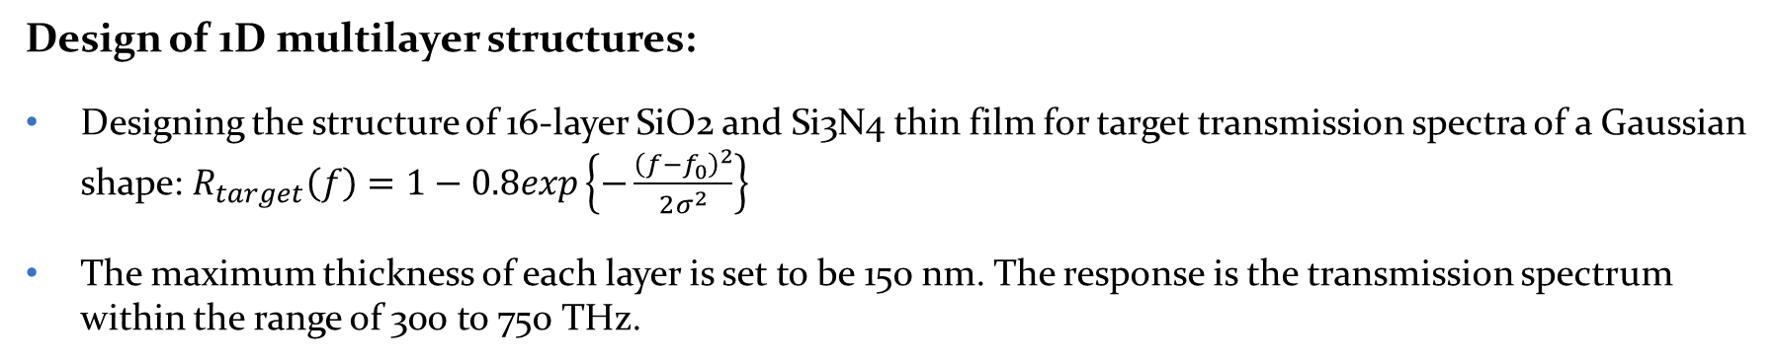



Design of 1D Multilayer Structures
Design of 1D multilayer structures:
Designing the structure of 16-layer SiO2 and Si3N4 thin film for target transmission spectra of a Gaussian shape: $R_{target}\left(f\right)=1−0.8exp\left\{−\frac{{\left(f−f_{0}\right)}^{2}}{2σ^{2}}\right\}$
The maximum thickness of each layer is set to be 150 nm. The response is the transmission spectrum within the range of 300 to 750 THz.
$$σ=75 THz$$
$$σ=37.5 THz$$
$$σ=18.75 THz$$

Slide 14
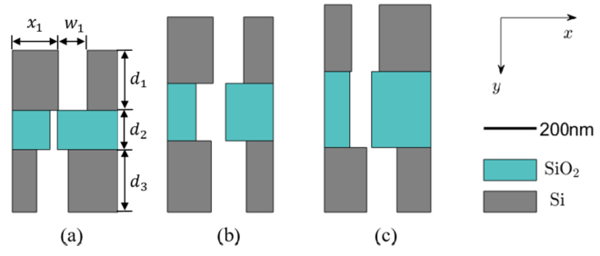
Design of 2D Structures
Design of 2D structures:
Designing 2D structures to modulate transmission phase delay independently at three wavelengths: R (470 nm), G (540 nm), B (667.5 nm).
The designed units are composed of 3 layers of Si and SiO2. Within each layer, part of Si or SiO2 is removed to form a rectangular slot. The design parameters are thicknesses of the 3 layers d_{i} (i = 1, 2, 3), the location x_{i} and width w_{i} of the vacuum slot in the ith layer (i = 1, 2, 3).
This meta unit can be used in a metasurface to create three-color holograms.

Slide 15
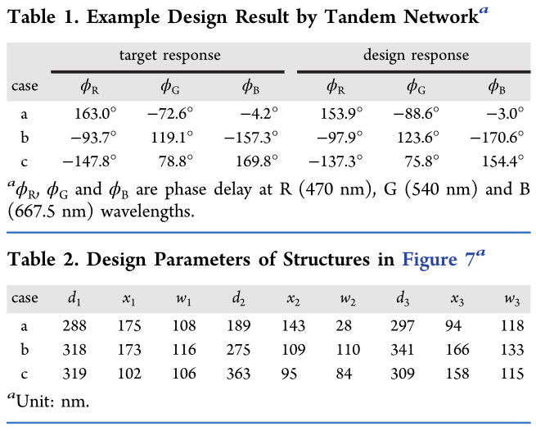
Design of 2D Structures
Design of 2D structures:
The training data set includes 750 000 instances and test data set includes 5000 instances.
The phase delay of the designed structure has an average error of 16.0°.

Slide 16
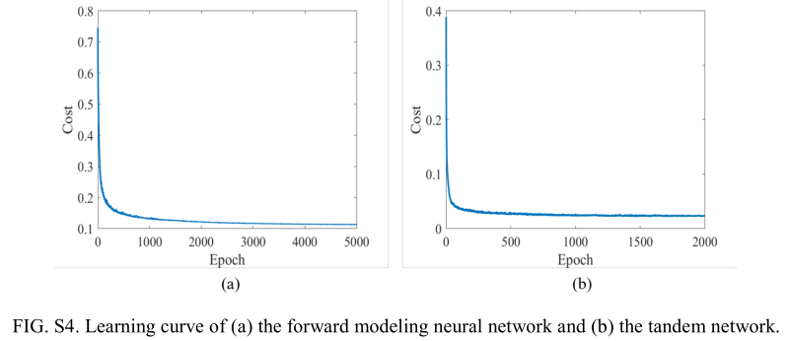
Design of 2D Structures
Design of 2D structures:
The forward modeling neural network has 6 hidden layers with each layer having 1024 – 512 – 512 – 256 – 256 – 128 hidden units.
The inverse design network has 2 hidden layers with 512 and 256 hidden units.

Slide 17
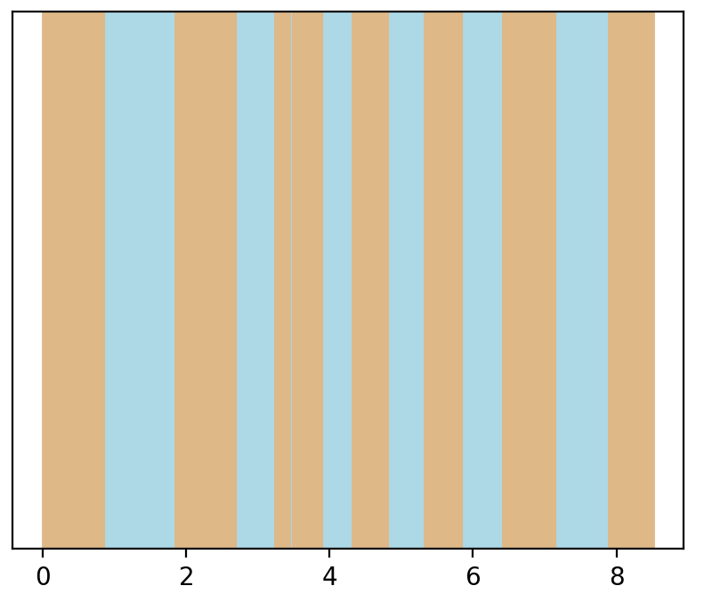

Our Model
Our model:
Nanophotonic structures: multilayer films consisting of 15 alternating layers of SiO2 and Si. The thicknesses of layers are uniformly distributed from 0 to a.
Responses: transmission spectra at 200 frequencies from 0.15 c/a to 0.25 c/a.
The responses are calculated analytically using evolution operator approach a.k.a. transfer matrix method (TMM)*.
Si
SiO2
$$\vec{k}$$
* G. N. Borzdov, Frequency Domain Wave-Splitting Techniques for Plane Stratified Bianisotropic Media, Journal of Mathematical Physics 38, 6328 (1997).

Slide 18
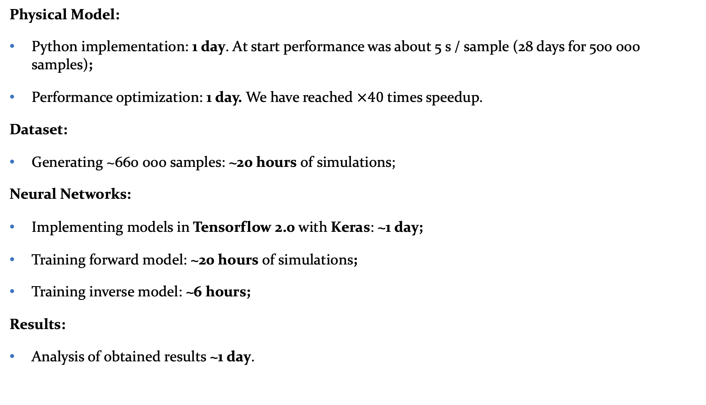
Implementation
Physical Model:
Python implementation: 1 day. At start performance was about 5 s / sample (28 days for 500 000 samples);
Performance optimization: 1 day. We have reached $×40$ times speedup.
Dataset:
Generating ~660 000 samples: ~20 hours of simulations;
Neural Networks:
Implementing models in Tensorflow 2.0 with Keras: ~1 day;
Training forward model: ~20 hours of simulations;
Training inverse model: ~6 hours;
Results:
Analysis of obtained results ~1 day.

Slide 19
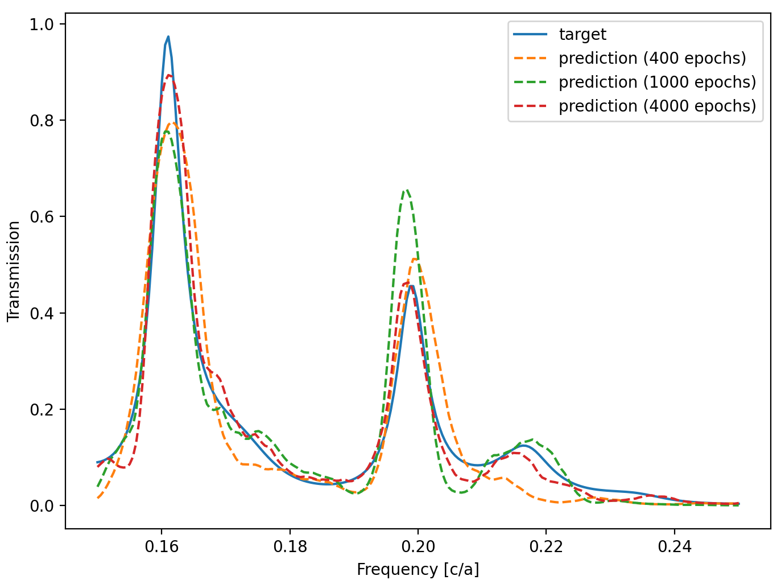
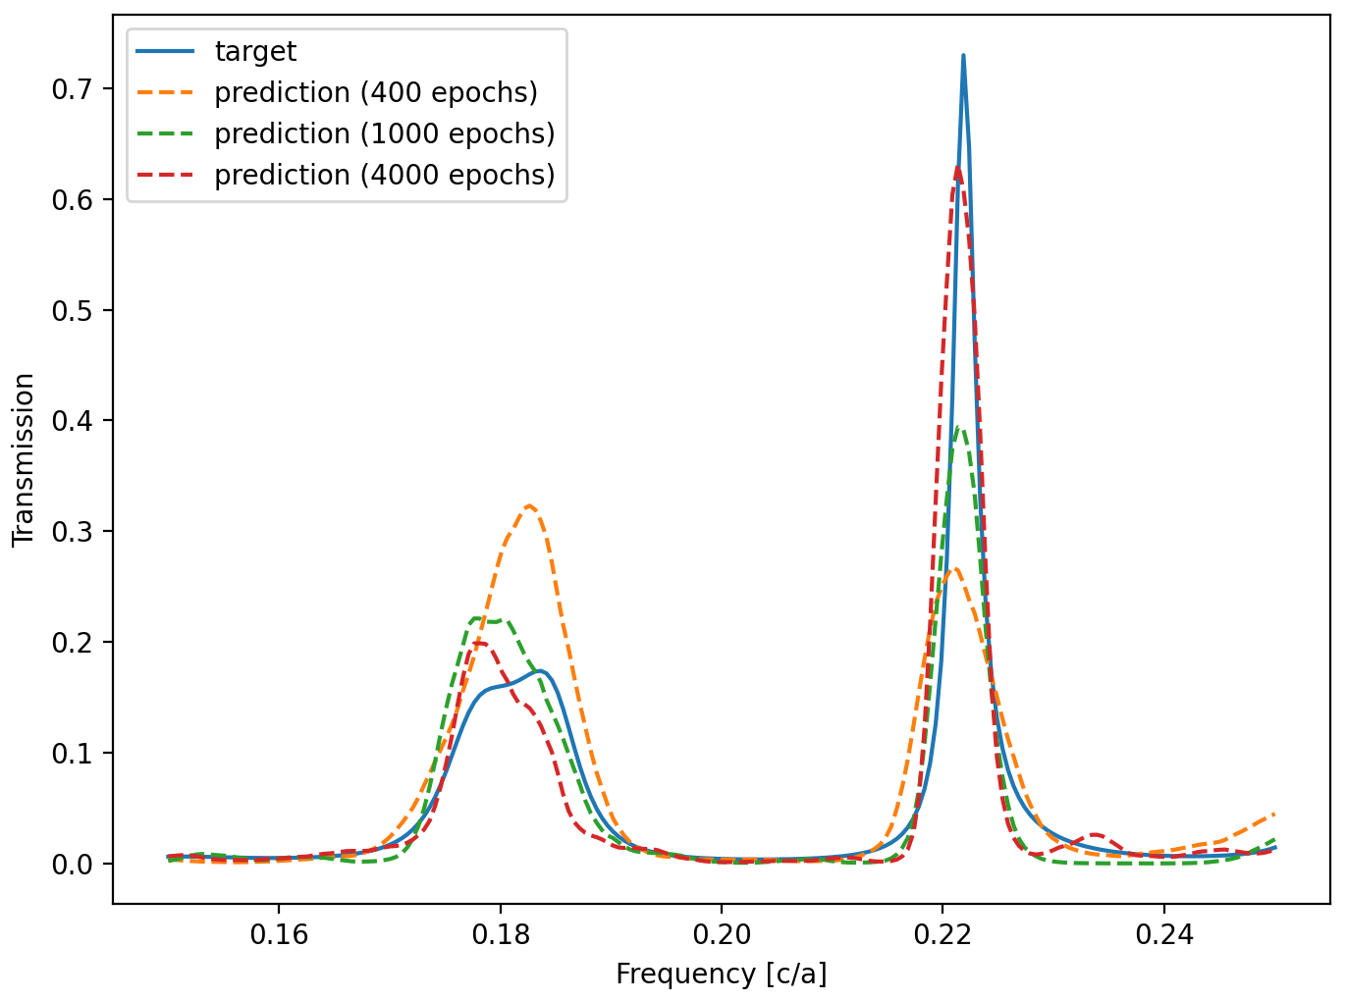
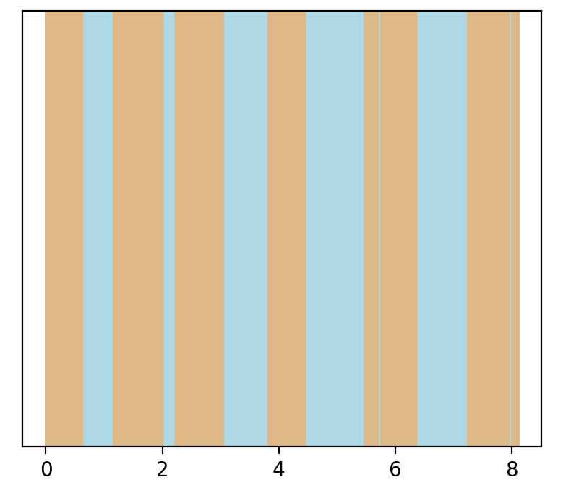
Simulation Results
Training a forward-modeling network:
Architecture 4 is used with 4 hidden layers 15 − 500 − 200 − 200 − 200 − 200.
Activation function: sigmoid.
Training set = 588429 samples, validation set = 65381 samples (10% of all data)
Random seed = 18
Random seed = 8
Grating design
Grating design

Slide 20
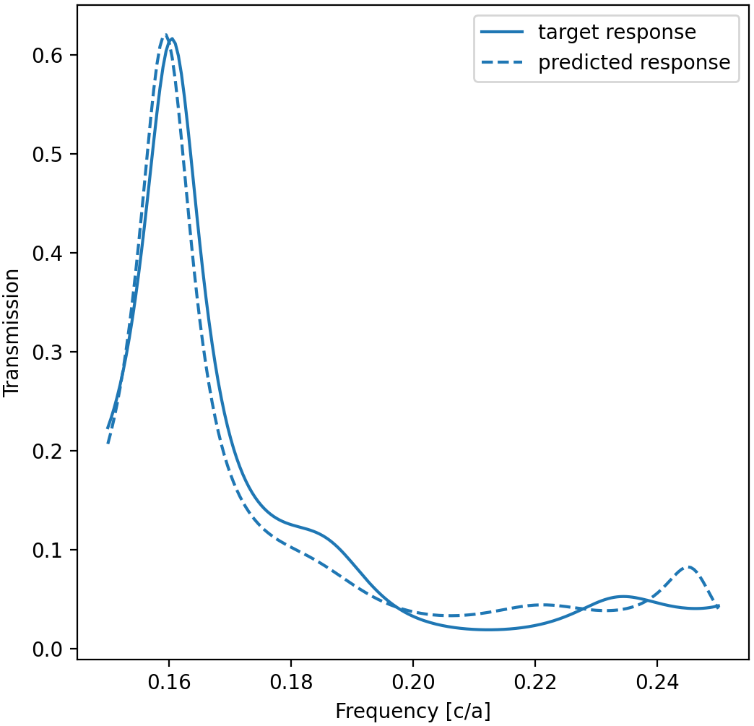
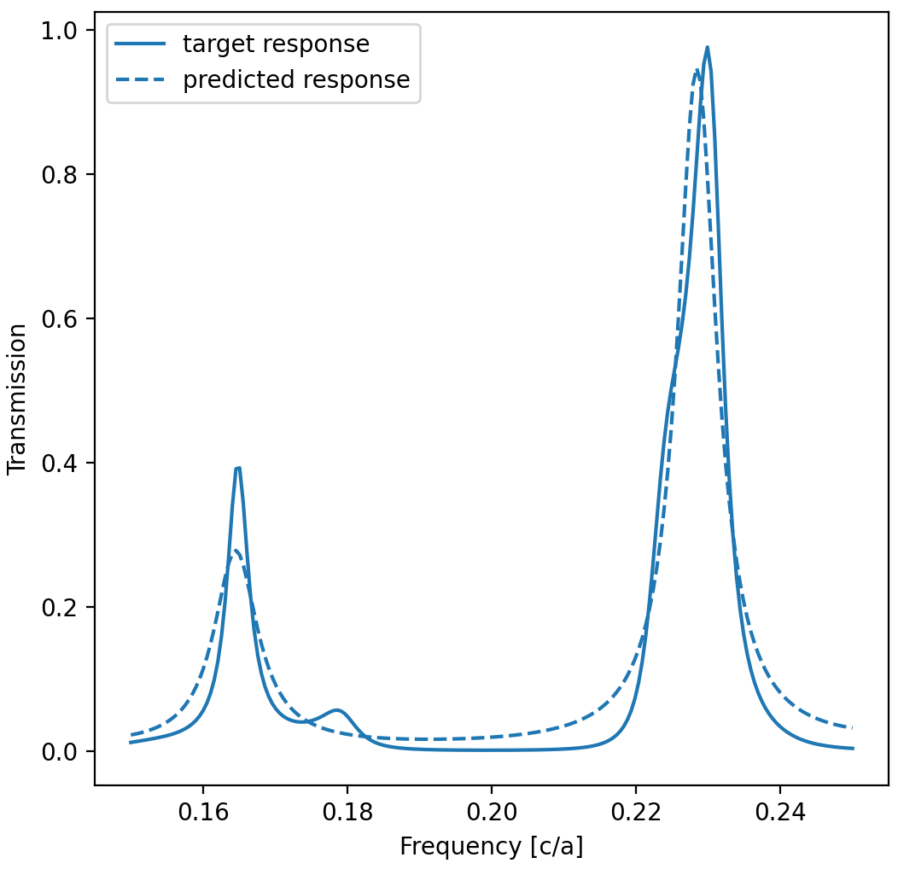
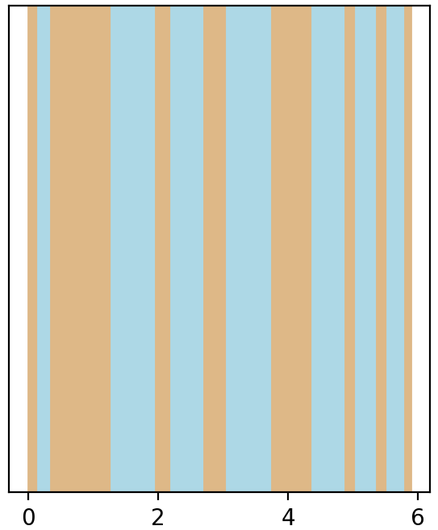
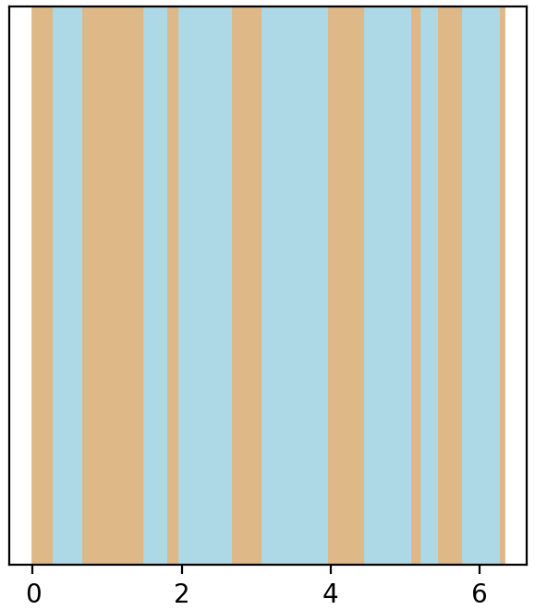
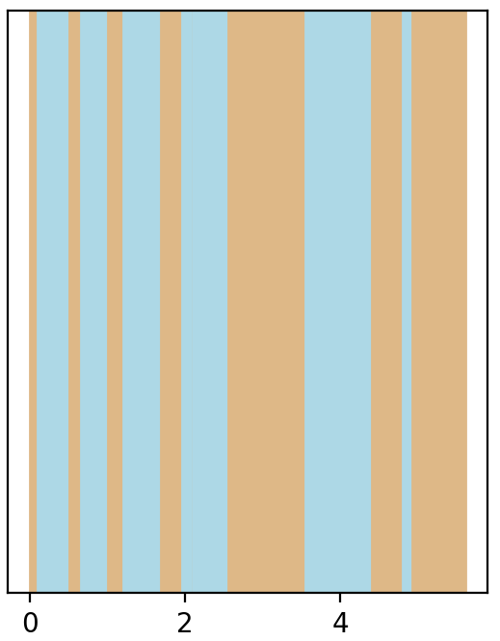
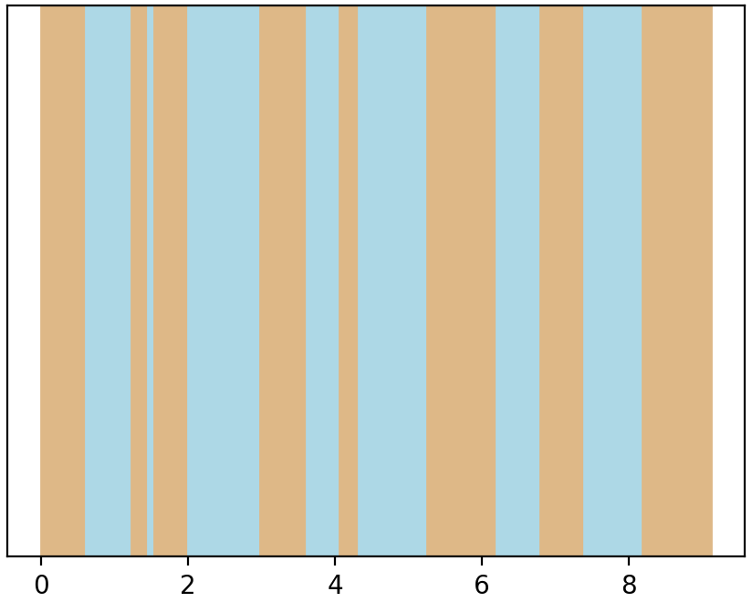
Simulation Results
Training a tandem network:
Inverse-modeling NN architecture: 2 hidden layers, neurons 200 − 500 − 200 − 15.
Trained with 400 epochs.
Random seed = 33
Random seed = 8
Predicted design
Predicted design
True design
True design
Notes:
Predicted designs are not necessarily similar to actual ones but give similar performance.

Slide 21
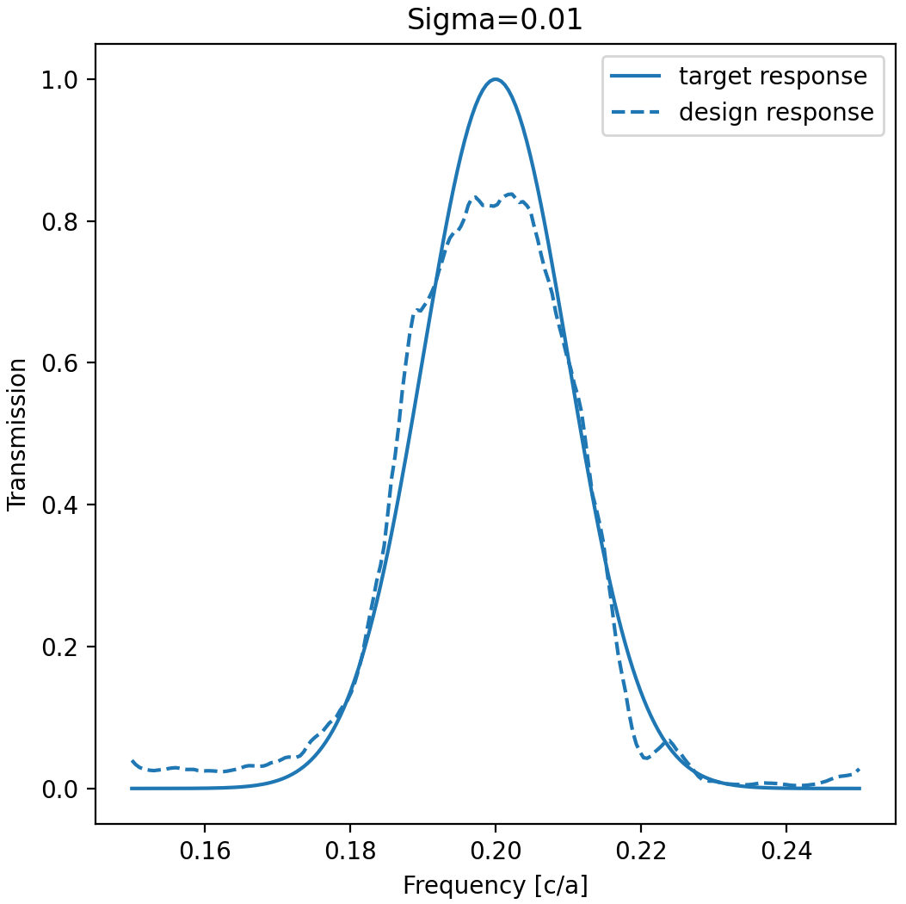
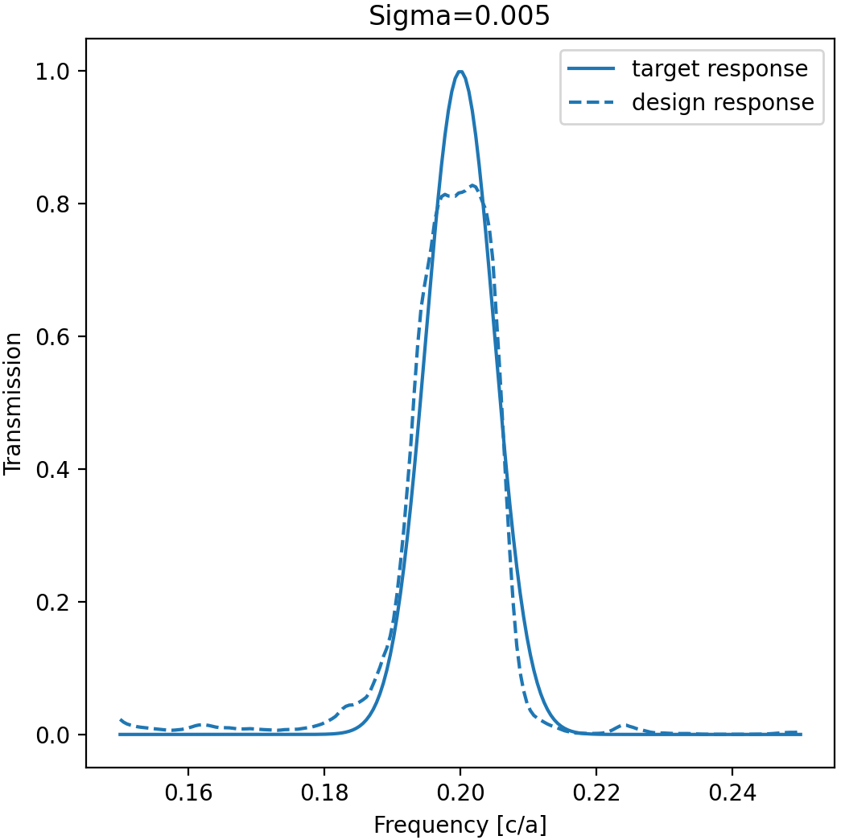
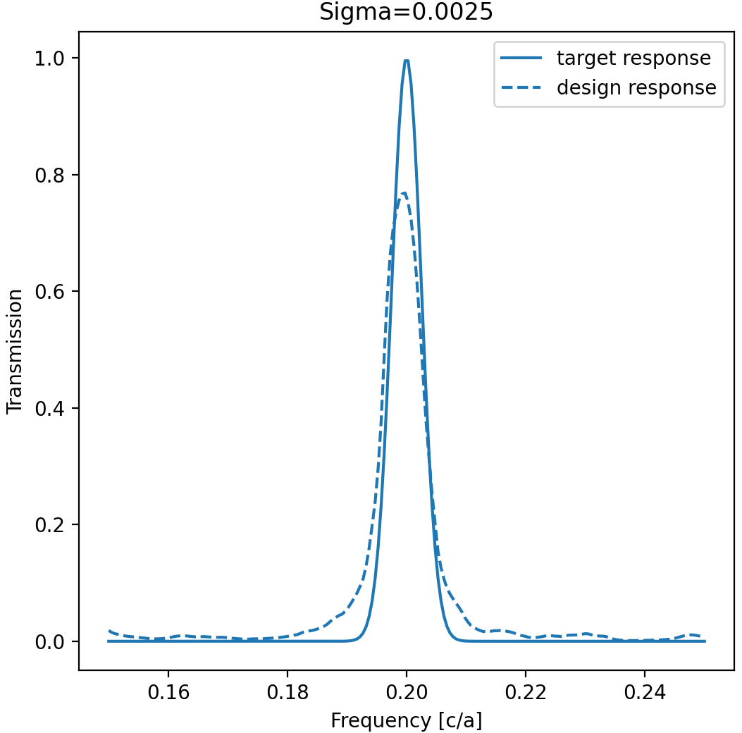
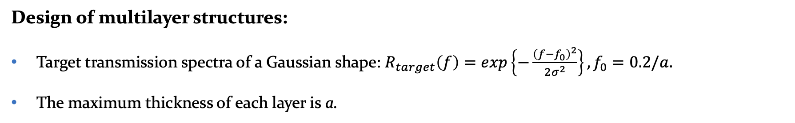
Simulation Results
Design of multilayer structures:
Target transmission spectra of a Gaussian shape: $R_{target}\left(f\right)=exp\left\{−\frac{{\left(f−f_{0}\right)}^{2}}{2σ^{2}}\right\},f_{0}=0.2/a.$
The maximum thickness of each layer is a.

Slide 22
Conclusion
Using neural networks for the inverse design suffers from the problem of nonuniqueness, a typical issue in the inverse scattering problem.
This issue makes it very difficult to train neural networks on a large training data set, which is often needed to model complex photonic structures.
Tandem architecture is proposed. It overcomes inverse design problem and provides a way to train large neural networks for the inverse design of complex photonic structures.
We built our inverse design network using the proposed approach.
We created a project on GitHub https://github.com/FiodarM/InvDesignNet.

